Slide 1
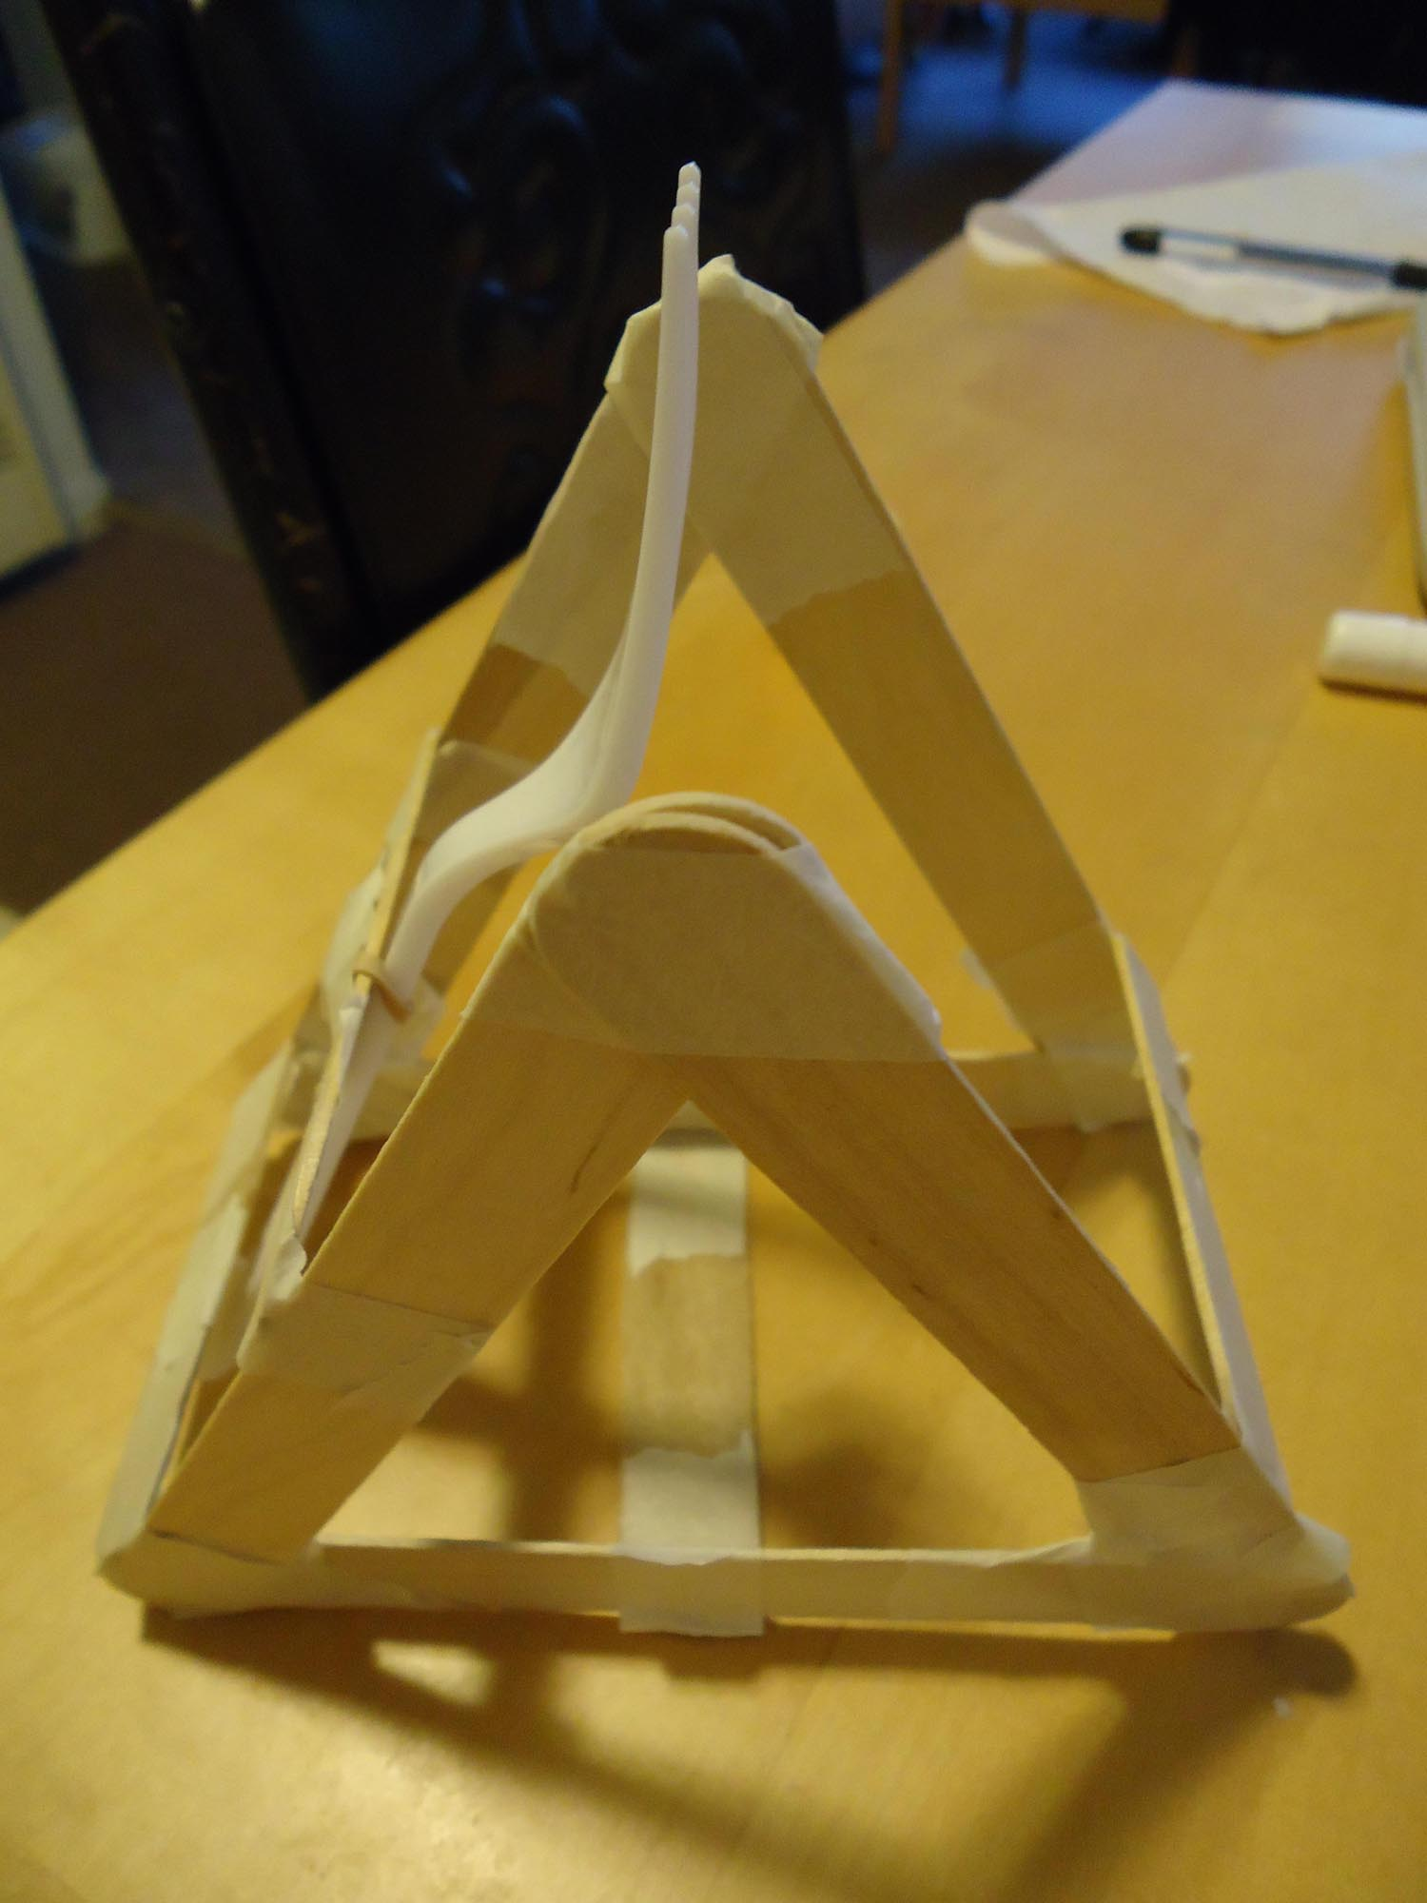
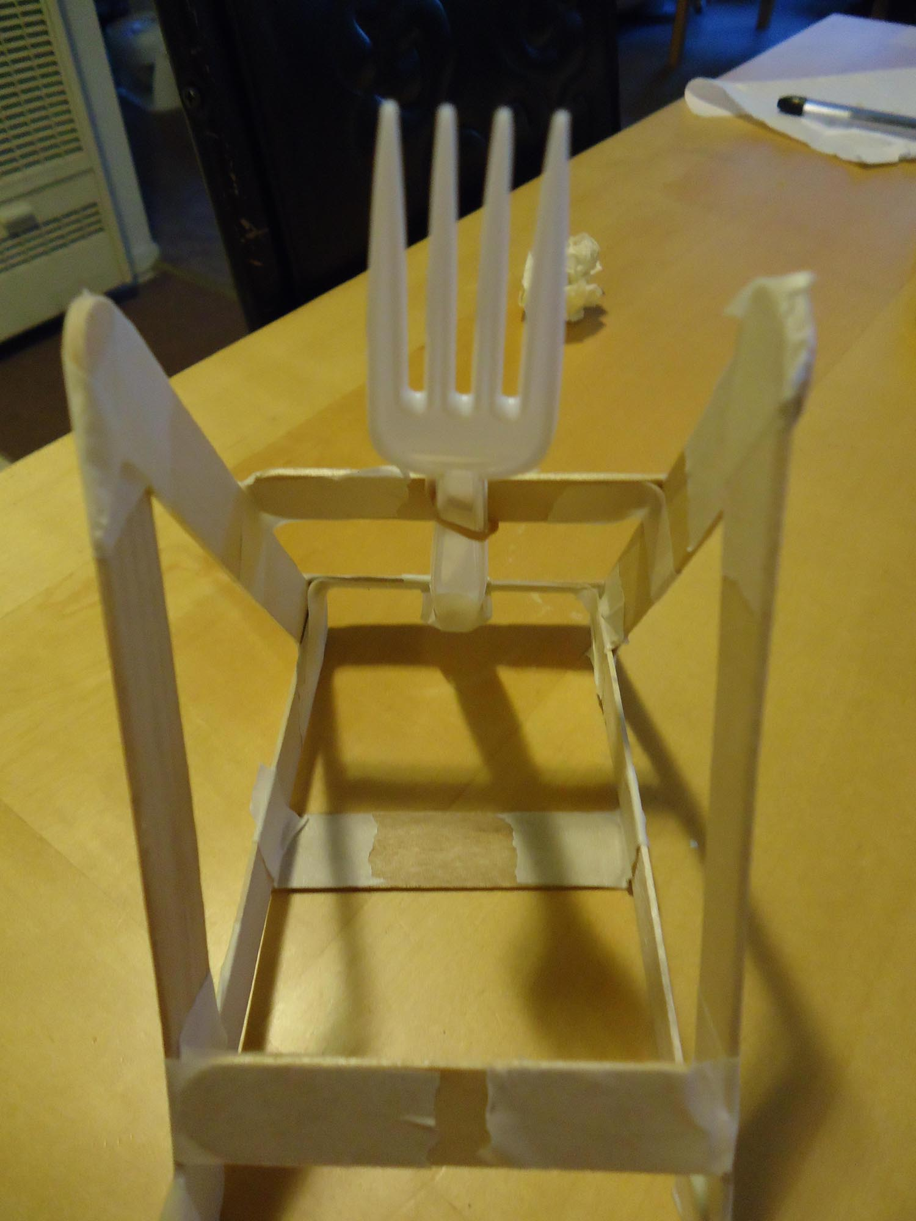
Marshmallow Catapults! Author: Robert Chen

Slide 2
Lesson at a Glance
Objective: Build a functioning catapult
Teaching Goals:
Levers and Torque
5-step Design Process
Rubber band, potential → kinetic energy
Projectile motion

Slide 3
Agenda
Intro (10min)
Talk about levers, torque,
Give them paper and pens to plan their design
Give materials only after they have plans
Build (30min)
Have them point out lever components on their designs
Point out rubber band energy
Test (15min)
Point out projectile motion
Cups for target practice
There is teachable material in every phase. Don’t just let them free after the introduction.

Slide 4
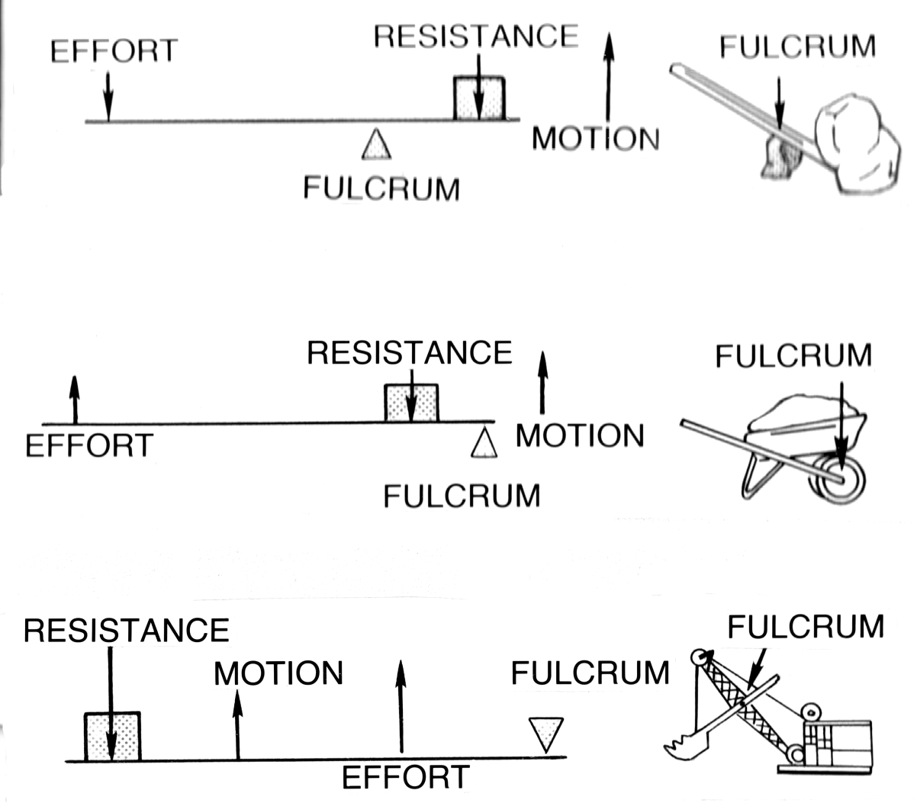
Levers
Three components:
Fulcrum
Input force, effort
Output force, load
Three classes
1st: Crowbar, scissors
2nd: Wheelbarrow, bottle opener
3rd: Tweezers, our catapult!
Teach components and make sure they can identify them. The 3 classes don’t matter.

Slide 5
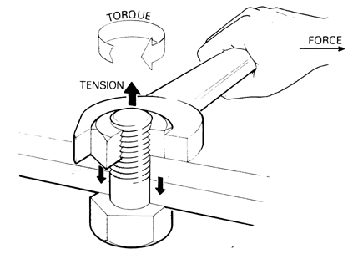
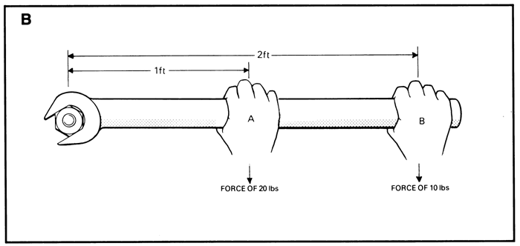
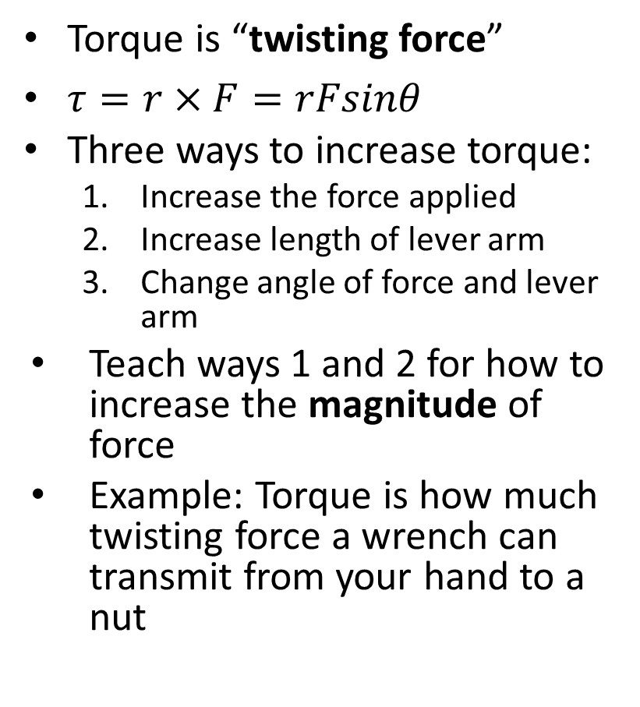
Torque
Torque is “twisting force”
$τ=r×F=rFsinθ$
Three ways to increase torque:
Increase the force applied
Increase length of lever arm
Change angle of force and lever arm
Teach ways 1 and 2 for how to increase the magnitude of force
Example: Torque is how much twisting force a wrench can transmit from your hand to a nut

Slide 6
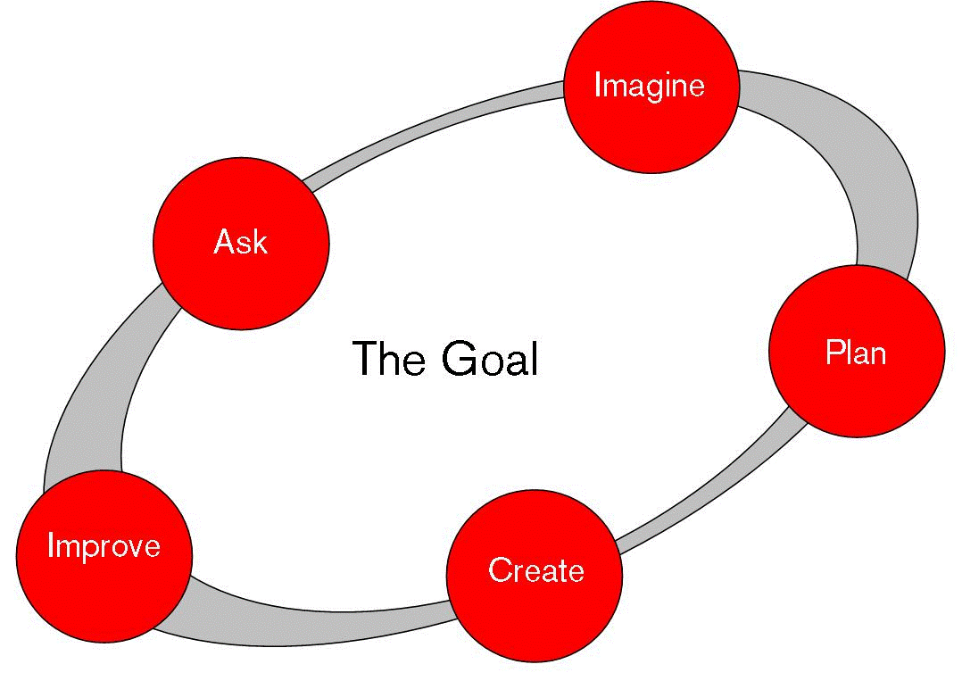
5-Step Engineering Design Process

Slide 7
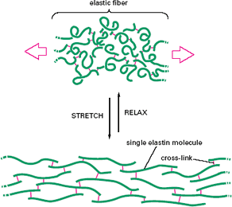
Rubber Band
Teach this while they are building their catapults.
You store energy by stretching the band
Rubber bands store potential energy, and release kinetic energy
When you get hit by a rubber band, you feel the transfer of energy
For mentors only: What’s really going on

Slide 8
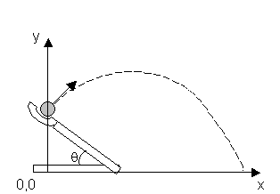
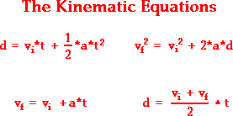
Projectile Motion
Teach this while they are launching their marshmallows
Teach the general arc/parabola shape and that it is predictable
Notes:
Work example if necessary.

Slide 9
Building Tips
Keep your catapults as examples.
Give them freedom to be creative.
Simplest catapult is spoon on top of cup.
Make the fulcrum as rigid as possible.
Start in 2D then fold into 3D.

Slide 10
Stuff to Try
Change the # of bands or fold one band over.
Change the marshmallow’s trajectory.
Change the lever arm length.
Change how high up along the spoon the rubber band is attached.
Compete against your mentors!

